Slide 1
Data Visualization
BD2K 18-1 | Introduction to Visualization
Jackie Wirz, PhD | Oregon Health & Science University

Slide 2
Learning Objectives
1
Understand why visualization important
Be able to describe data and how its intrinsic properties can be used to create a visualization
Identify major types of visual properties
Understand the steps used to create a visualization
2
3
4

Slide 3
The Big Questions

Slide 4

what is graphical
excellence?
Hello there!

Slide 5
how can i make my data visually excellent?
Hello there!

Slide 6

What this talk is not about…
Highly technical visualizations
Software-specific tools
Infographics
This is a great opportunity to insert images specific to your learning environment! We suggest graphics that fill the entire slide, and creating a separate slide for each topic mentioned here.

Slide 7
What this talk is about…
useful
aim here!
ugly
pretty
crap

Slide 8
1 | Start
2 | Substance
3 | Style
4 | Steps

Slide 9
1 | Start
Why are we doing this, anyway?

Slide 10


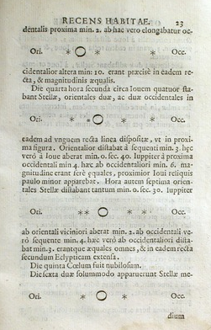
Why are we doing this anyway?
In 1610, Galileo Galilei published Sidereus Nuncius, which featured figures directly inserted into the main body text. He created the concept of "oculate certitudine”, which loosely translates as "visible certainty” – wordy arguments become unnecessary when visual, evidence-based data is presented.
By Scan: History of Science Collections, University of Oklahoma Libraries Original: Galileo Galilei [Public domain], via Wikimedia Commons

Slide 11
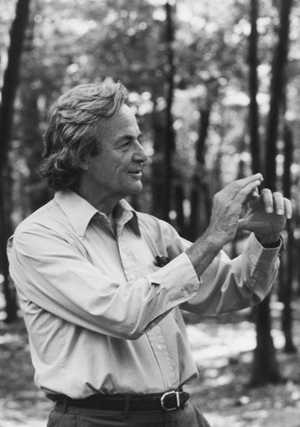
Why are we doing this anyway?
“What I am really try to do is bring birth to clarity… It's all visual. It's hard to explain.” - Richard Feynmann
Visual representations can help clarify complex ideas and concepts in a way that may be unattainable through written words.
Tamiko Thiel 1984 (OTRS communication from photographer) [CC BY-SA 3.0 ], via Wikimedia Commons

Slide 12
Why are we doing this anyway?
“If information is presented orally, people remember about 10%, tested 72 hrs after exposure. That number goes up by 65% if you add a picture.” - John Medina
Insert a compelling picture here! Or use a photo from the source material: http://www.brainrules.net/

Slide 13
2 | Substance
Defining your data – what exactly are we working with?

Slide 14
Describe your data

Slide 15

Quantitative | Qualitative
People tend to think about data as strictly quantitative (measurable) or qualitative (descriptive or subjective). In reality, quantitative data always exists with qualitative aspects.
Think of your data. What portions of it are quantitative? What are qualitative? Let’s say I’m doing a study on distance traveled by garden gnomes. The distance is quantitative (miles, kilometers, depends on American or European gnome): but the item that is traveling is a gnome of some qualitative type. The distance traveled does not exist in a vacuum – it is performed by an entity that must be qualitatively described!

Slide 16
Quantitative - Qualitative
Understanding the quantitative and qualitative aspects of your data will help you better determine how to visualize it.
Quantitative values should be encoded with visual techniques that humans can assess with some level of quantitative accuracy.
Qualitative values should be encoded with techniques that are appropriate for the type of qualitative data.

Slide 17
Quantitative - Qualitative
Ratio
Interval
Ordinal
Nominal
Statisticians oftentimes define data as ratio, interval, ordinal or nominal.
Stevens, S. S. (7 June 1946). "On the Theory of Scales of Measurement". Science 103 (2684): 677–680.

Slide 18
Quantitative - Qualitative
Ratio
Interval
Ordinal
Nominal
The exact definitions of ratio vs interval data have to do with their mathematical properties. I prefer to think of them as values with a quantitative component

Slide 19
Quantitative - Qualitative
Values
Relationships
Ratio
Interval
Ordinal
Nominal
Ordinal and nominal classifications are ways of qualitatively describing how the data is related to itself.

Slide 20
Quantitative - Qualitative
Values
Relationships
Ratio
Interval
Ordinal
Nominal
Ordinal data has an implied natural ordering. Nominal data, sometimes called categorical data, may exists in categories but there is no implied order.

Slide 21
So what?

Slide 22
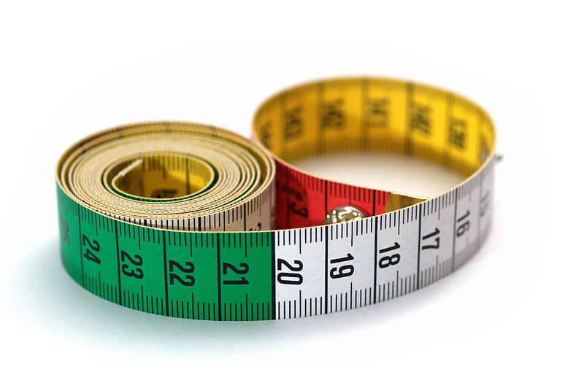
Implied graphical content
Values
When working with data, the values that are being measured have implied graphical content. You need to choose visualizations that work with the values and measurements appropriately. For example, when working with logarithmic data, you would not want to represent that on a linear scale.
By Simon A. Eugster (Own work) [GFDL (http://www.gnu.org/copyleft/fdl.html) or CC BY-SA 3.0], via Wikimedia Commons

Slide 23
Implied graphical content
Relationships
The relationships between the data will impact the graphical choice. Ordinal data, with an implied order, requires representation that faithfully represents the order. Categorical data needs to best represent the categories or characteristics that are most important to the data visualization. Understanding how the categories are defined will help define the visualization.

Slide 24
3 | Style
What is visual style, and how to I achieve it?

Slide 25
Pre-attentive processing

Slide 26

Features
Patterns
Objects
Visual interpretation can be loosely described as a three step process. Initial visual processing starts with recognition of gross features. The brain then processes patterns, followed by delving into memory to identify specific objects.

Slide 27
Features
Patterns
Objects
Pre-attentive
Working Memory
The initial processing steps occur extremely rapidly and can identify specific visual properties quickly and accurately. These features are pre-attentive. Importantly, multiple pre-attentive features can be processed simultaneously without increasing working time. This means that pre-attentive visual properties can be used in parallel to convey information.

Slide 28
So what are pre-attentive features?
Line orientation
Length
Width
Size
Curvature
Number
Color
.
.
.
visual encodings
For great pre-attentive feature visualizations and further explanations, check out Christopher Healey’s page at http://www.csc.ncsu.edu/faculty/healey/PP/

Slide 29
Good visualizations use pre-attentive processing to reduce cognitive burden

Slide 30
So, how do we use pre-attentive features to encode info?

Slide 31
Visual Encoding:
Pattern

Slide 32
The human eye is very good at grouping. Shapes of similar size are easily recognized as being part of a common group. Discrete points are good representatives of non-continuous data
Next, we are good at comparing lengths of items along a common axis. We can do this fairly quantitatively.
We can differentiate different sizes and shapes quickly, but complex or a large number of shapes confound our ability to detect patterns.

Slide 33
Visual Encoding:
Values

Slide 34
We are most quantitatively able to differentiate lines along a common axis.
Next, we are pretty decent at quantitatively understanding angles, but do better with angles less than 90 degrees.
Area is difficult for humans to quantitatively differentiate. Oftentimes people increase the radius by two, but the volume is not correspondingly doubled!
Volume is extremely difficult, and should not be used for any quantitative purposes. 3D representations very rarely encode useful information.

Slide 35
Visual Encoding:
Color

Slide 36
Color has incredible power – it can be used elegantly to make visuals easier to understand, but it can be abused.
In addition to changes in hue, visual designers can use changes in intensity to help encode information.

Slide 37
Perception of visual encoding

Slide 38
Quantitative - Qualitative
Association - Differentiation
Notes:
Cleveland and McGill 1985

Slide 39
4 | Steps
What is a logical data visualization protocol?

Slide 40
A Protocol for Visualization

Slide 41
1 | Gather the Data
2 | Organize the Data
3 | Write a Story/annotate
4 | Select a visualization
5 | Apply encodings
6 | Experiment & Iterate

Slide 42
Gather the data
1
You may be gathering the data yourself, or you may be compiling data from other sources. Always be thinking about how to best describe the data, and what quality of data is necessary to answer your question.
Insert an image of raw data here that is most applicable to your work.

Slide 43
Organize the data
2
Organizing the data includes describing it, cleaning the data, and putting it into a useable format. This step oftentimes takes the most time!
Insert an image of raw data here that is most applicable to your work.

Slide 44
Write a story / annotate
3
When playing with the data, interesting patterns or questions will come up – when you have hit upon a story that you want to visualize, it is important to pull it together with the contextual information. Write the story of the visualization you are creating in sentence format - Include the question, the process and the answer. Annotate the story with the data you will be using, things you want to highlight, etc.
Insert an image of raw data here that is most applicable to your work.

Slide 45
Select a visualization
4
Choose a visualization that best fits your story. For example, if you are displaying relational data that is independent of time, consider a force diagram.
Insert an image of raw data here that is most applicable to your work.

Slide 46
Apply encodings
5
With the data you have, play around with the encoding properties that work best for the information. Remember to try and use as many pre-attentive features as possible to decrease cognitive load.
Insert an image of raw data here that is most applicable to your work.

Slide 47
Experiment and iterate
6
When developing visualizations, inevitably new questions and aspects of the story come to light – experiment and play around with your data to further refine the story your data is telling. Be flexible and iterate the types of encodings and visualizations you are using.
Insert an image of raw data here that is most applicable to your work.

Slide 48
Play with your data,
play with your visualizations!

Slide 49
1 | Start
2 | Substance
3 | Style
4 | Steps

Slide 50
what is graphical
excellence?
Hello there!

Slide 51
Good visualizations understand the data, encode it appropriately, and present a story.

Slide 52
how can i make my data visually excellent?
Hello there!

Slide 53
Practice by identifying superior visualizations, then dissecting how they encoded the data attributes to best tell their data’s story.

Slide 54
Learning Objectives
1
Understand why visualization important
Be able to describe data and how its intrinsic properties can be used to create a visualization
Identify major types of visual properties
Understand the steps used to create a visualization
2
3
4

Slide 55

Resources:
Color
http://www.color-blindness.com
http://www.etre.com/tools/colourblindsimulator/
http://www.vischeck.com/

Slide 56
Resources:
Pre-attentive
http://www.csc.ncsu.edu/faculty/healey/PP/
https://www.youtube.com/watch?v=UFNzATczkDU

